Slide 1



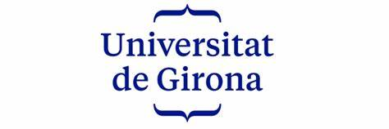
A Comparative Analysis Of Parametric & Non-parametric Model: Linear Regression Vs. KNN
REGRESSION CHALLENGE:
Presentation by:
Daniel Tweneboah Anyimadu

Slide 2
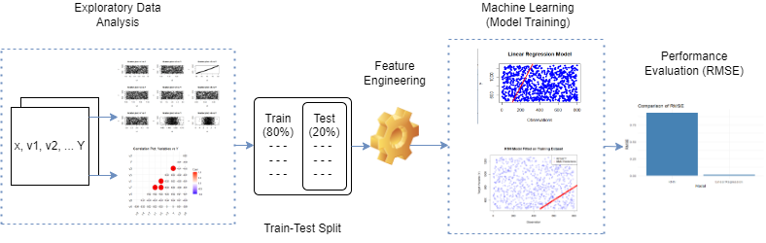
ABSTRACT
The data is subjected to exploratory data analysis, feature engineering, and model training using 10-fold cross-validation.
The models are evaluated based on their root mean squared error (RMSE) values on a test dataset.
The lm and KNN models achieved RMSE of 0.00 and 1.73 respectively on the test dataset. The findings provide insights into the strengths and limitations of each approach and offer practical implications for regression modeling.
This study presents a regression challenge and explores two different approaches, parametric and non-parametric, to solve the problem.
The aim is to compare the performance of linear regression (lm) and k-nearest neighbors (KNN) models in predicting a target variable based on a set of independent variables.
2

Slide 3
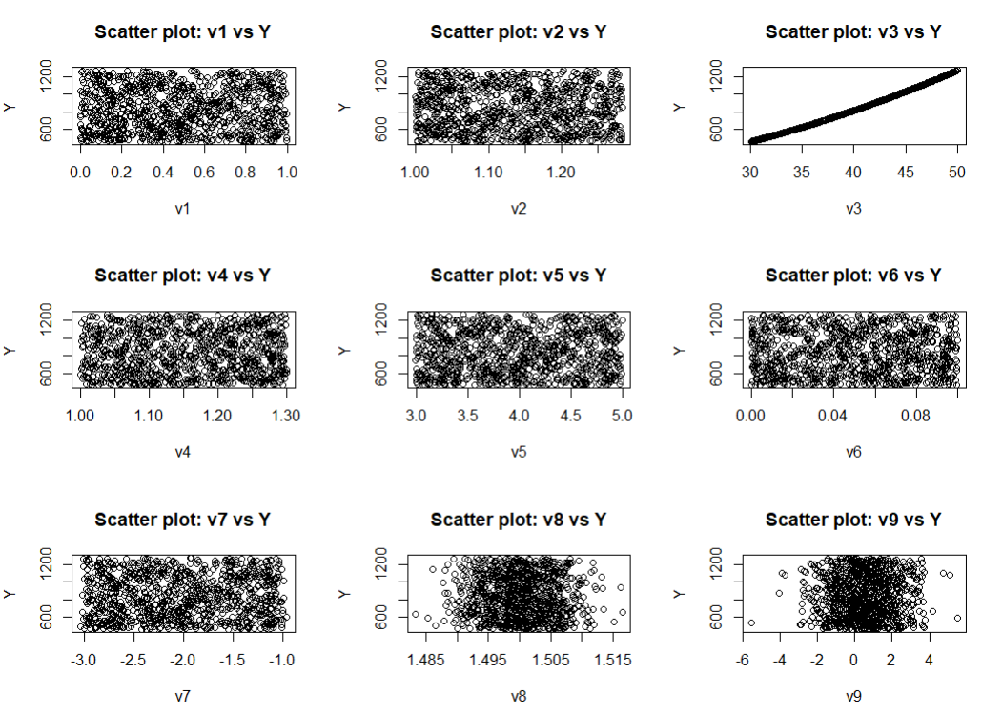
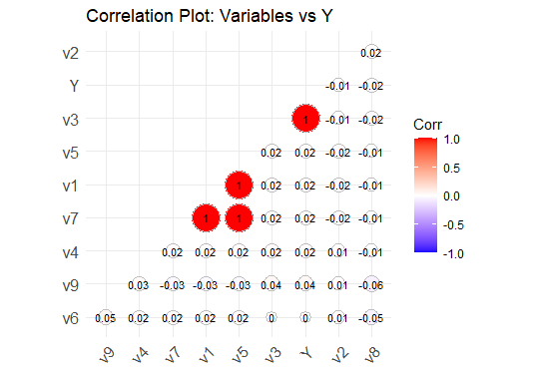
Exploratory Data Analysis (EDA)
Scatter Plot:
Correlation Matrix :
Only v3 has a linear relationship with Y, as shown in the scatter plot.
High collinearity exists between v1, v5, and v7, depicted in the correlation matrix.
3

Slide 4
Train-Test Split, Feature Engineering & Feature Selection
Train-Test Split:
Performed train-test split by creating subsets of the original training data.
This was split into 80% training, while the remaining 20% formed the validation dataset.
A seed value of 123 was set for reproducibility, ensuring consistent randomization of data.
Feature Engineering:
The provided code applies transformations (square and logarithm) to specific variables.
~ v3_sq = v3^2, v3_log = log(v3 + 1) : To capture non-linear relationships.
Feature Selection:
Creates a subset of features based on a predefined set of variables.
This includes v1, v2, v3, v4, v5, v6, v7, v3_sq, v3_log, and the target variable Y.
4

Slide 5
Machine Learning (Model Training)
Machine Learning Models:
This adjusts the model parameters to minimize the difference between the predicted and actual values of the target variable. Linear Regression & KNN models were trained.
Linear Regression (Parametric model):
The goal is to estimate the coefficients that best fit the data based on a specific functional form.
A linear equation is of the form:
Y = β0 + β1X1 + β2X2 + ... + βn*Xn + ε, where:
Y is the dependent variable.
β0 is the intercept term.
β1, β2, ..., βn are the regression coefficients.
X1, X2, ..., Xn are the independent variables.
ε is the error term (also known as the residual).
KNN(Non-Parametric model):
This model makes predictions based on the similarity between the input features and the neighboring data points in the training set.
The training process involves finding the optimal value of K.
The final value used for the model was k = 3.
This represents the number of neighbors considered for prediction.
5

Slide 6
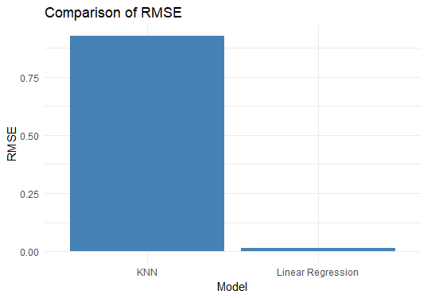
PERFORMANCE EVALUATION (RMSE)
MODEL | RMSE (VALIDATION) | RMSE (TEST)
Linear Regression with original features | 14.78256 | 218.437
Linear Regression with subset of original and engineered features | 0.01255 | 0.00014
KNN with original features | 6.67115 | 44.49397
KNN with subset of original and engineered features | 0.92752 | 1.73112
The results of the Linear Regression with subset of original and engineered features model on the 20% validation and actual test data outperformed all other models of linear regression and KNN.
Nonlinear transformations seem to have a significant impact in improving the model’s performance as it helps to capture non-linear relationship of the data.
6

